Slide 1
QA SYSTEM
By: Aabroo Zubair, Mehjabin Rahman, Pooja Venkatesh

Slide 2
Aims
Question and Answer Generation
Used multiple techniques to get right pairs of Questions and Answers from the book ‘Fire and Blood’
Built a platform
Create a website that will show the results of Questions and Answers

Slide 3
Question Answer generation
We have generated the answers in three ways,
Use the Hugging Face Transformer:
For this we have used “distilbert-base-cased” distilled-squad pretrained model.
Fed contexts and questions to the pipeline and extracted the answers
Use chat gpt API
For this we give the context, chat gpt create the questions and answers for that specific context
Manually
Manually extracted some question-answer pairs

Slide 4
Some Steps Before generating Question Answers
Divide the data file into small paragraphs and convert it into a CSV file
Get the NER of each row containing paragraphs

Slide 5
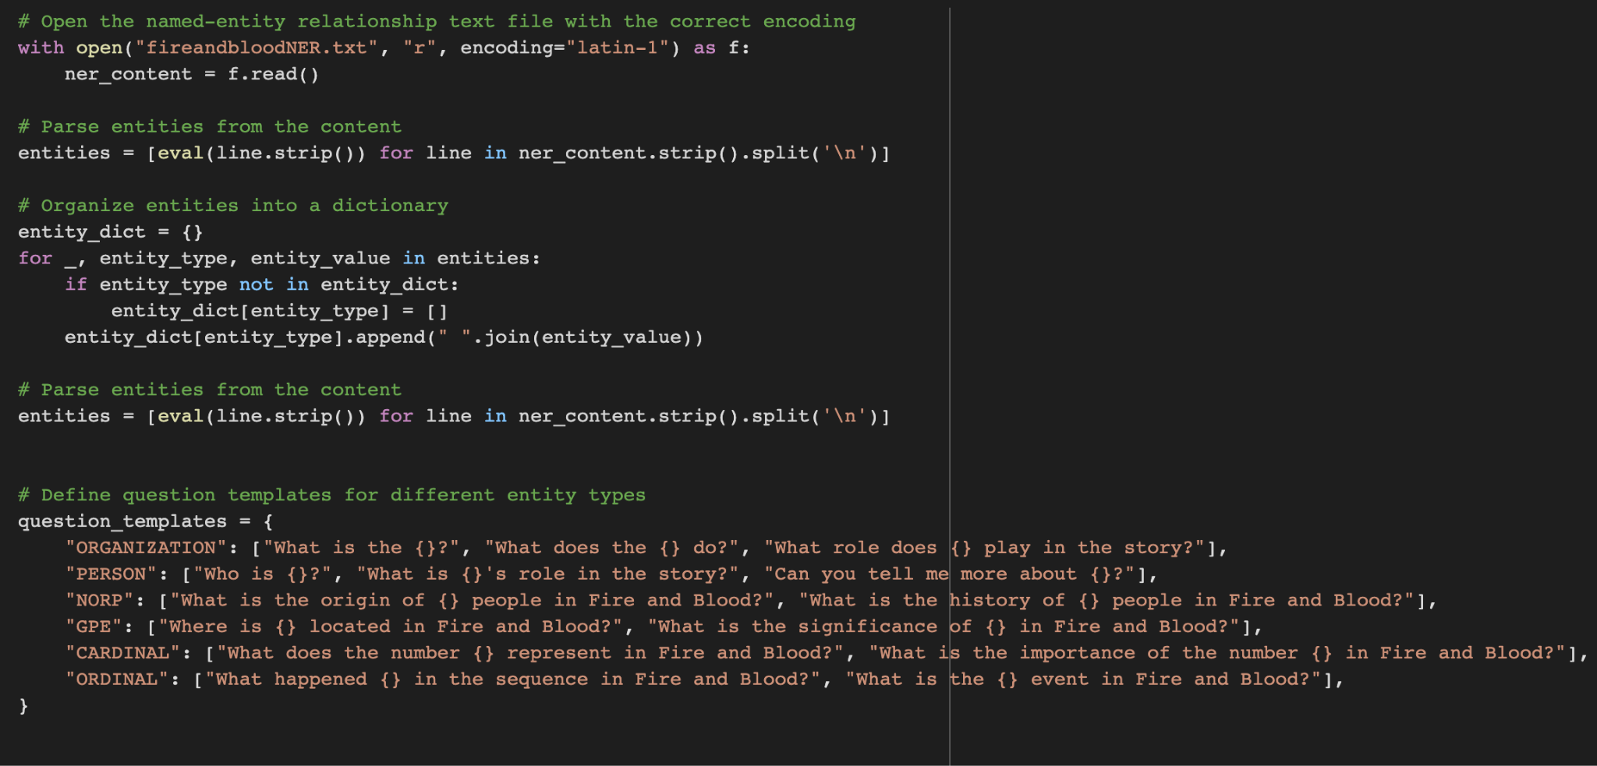
Code Snippet of Question Generation From NER

Slide 6
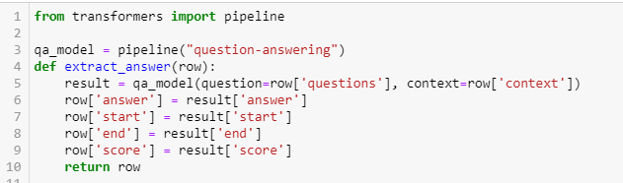
Code Snippet for hugging face pipeline

Slide 7
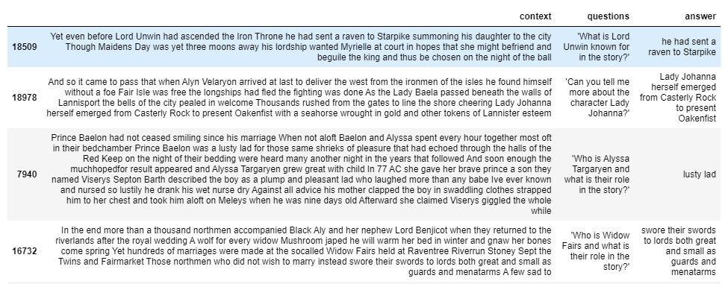
Sample generated answer from Hugging Face Transformer

Slide 8
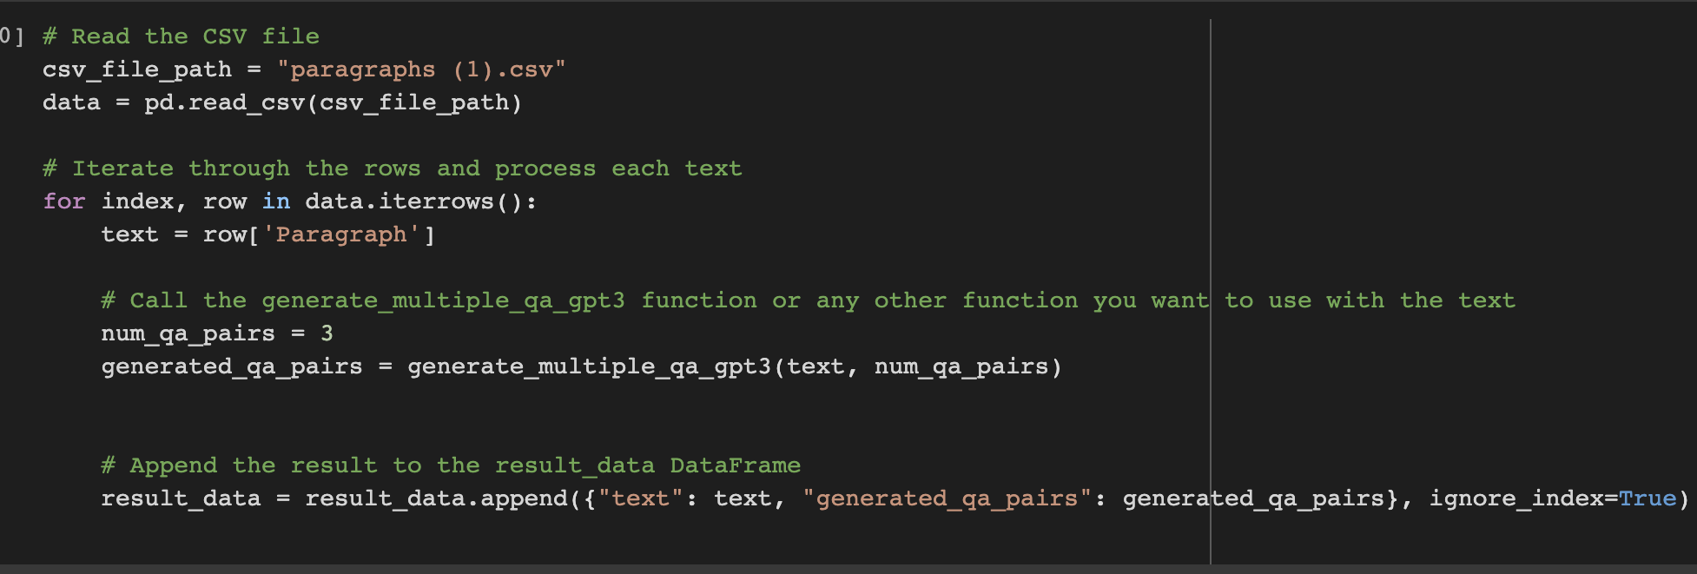
generating questions and answers from gpt3’s api

Slide 9
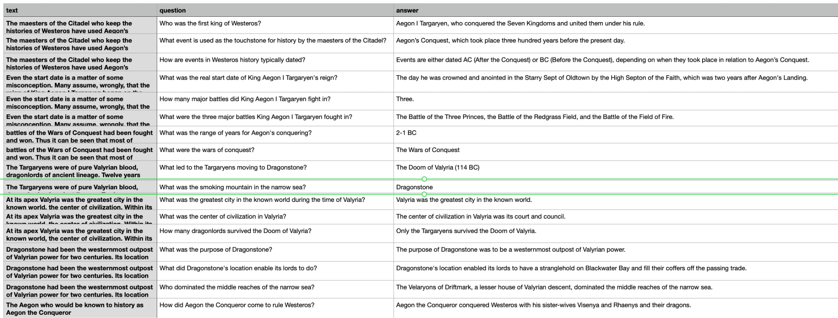
Sample of the few questions generated from api

Slide 10
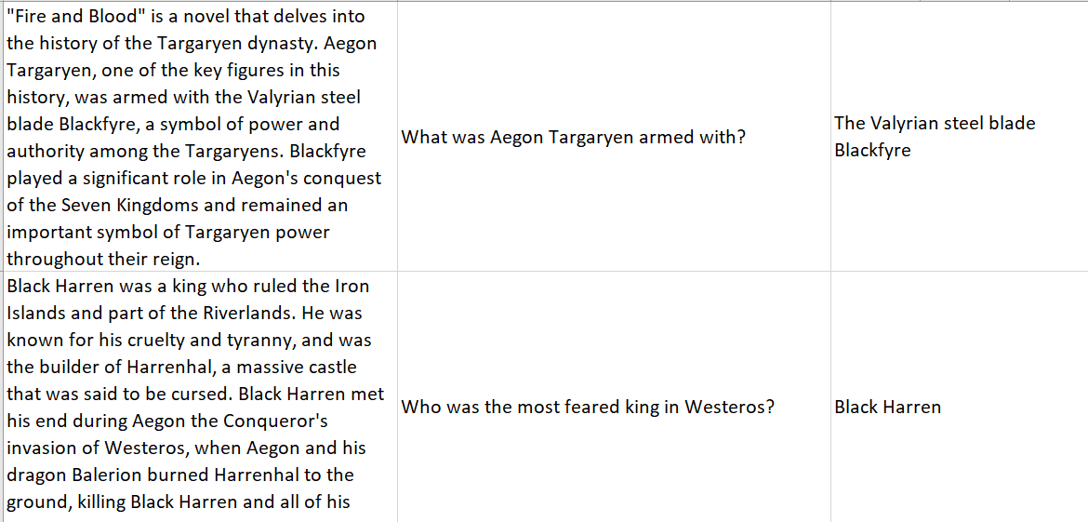
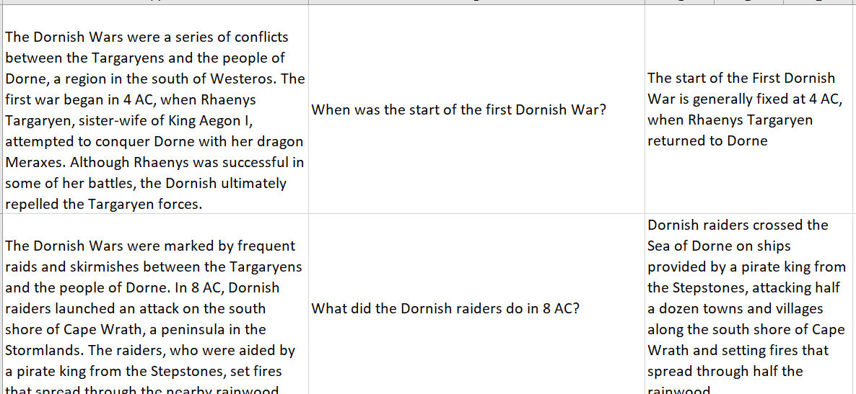
Manually generated answers

Slide 11
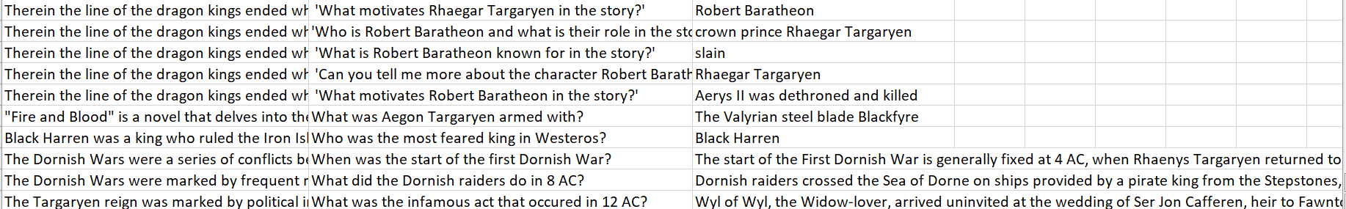
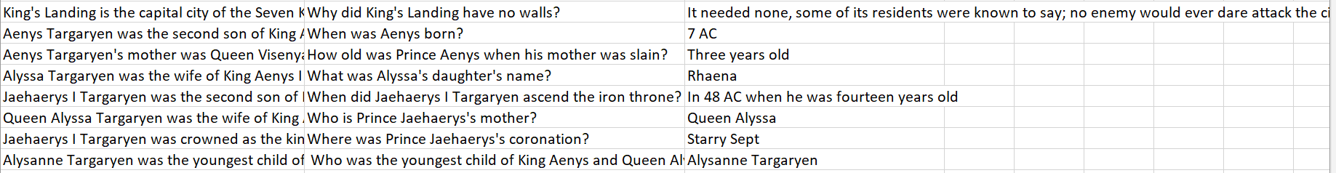
Updated DatASet
Using these three methods, we generated the answers. So our updated dataset looks like the following:

Slide 12
Question-Answering model using T5-base pretrained model
Preprocessed dataset
Split the dataset into train and test dataset

Slide 13
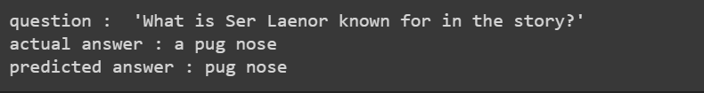
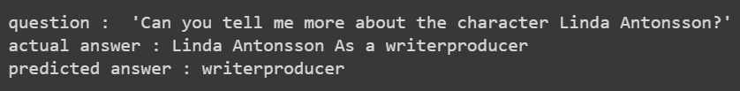
Samples of Predicted Answer

Slide 14
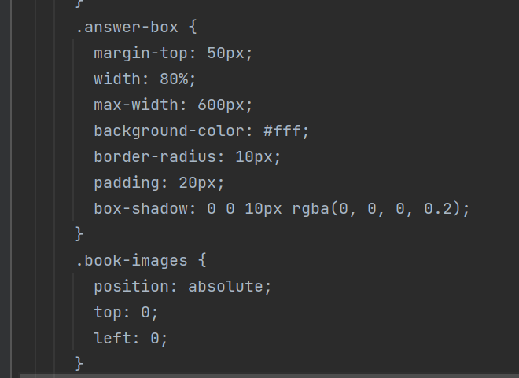
CODE FOR HTML PAGE

Slide 15
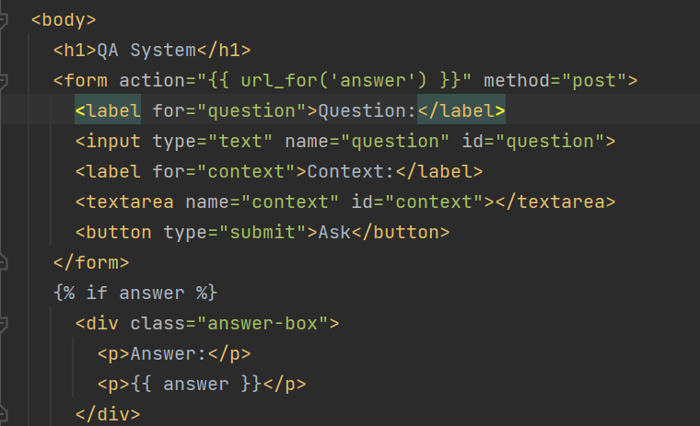
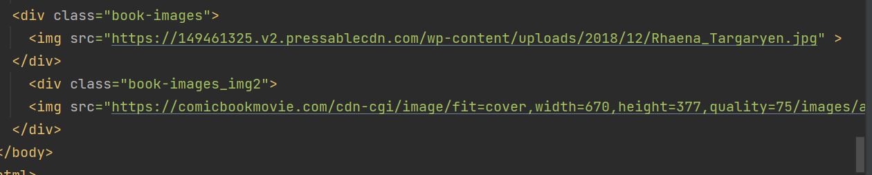
CODE FOR HTML PAGE CON’T

Slide 16
